Slide 2
Genesis 18:1-2
The Lord appeared to Abraham near the great trees of Mamre while he was sitting at the entrance to his tent in the heat of the day. Abraham looked up and saw three men standing nearby. When he saw them, he hurried from the entrance of his tent to meet them and bowed low to the ground.

Slide 3
Hospitality: To provide shelter and safety to the alien and stranger among you without expectation of repayment.

Slide 5
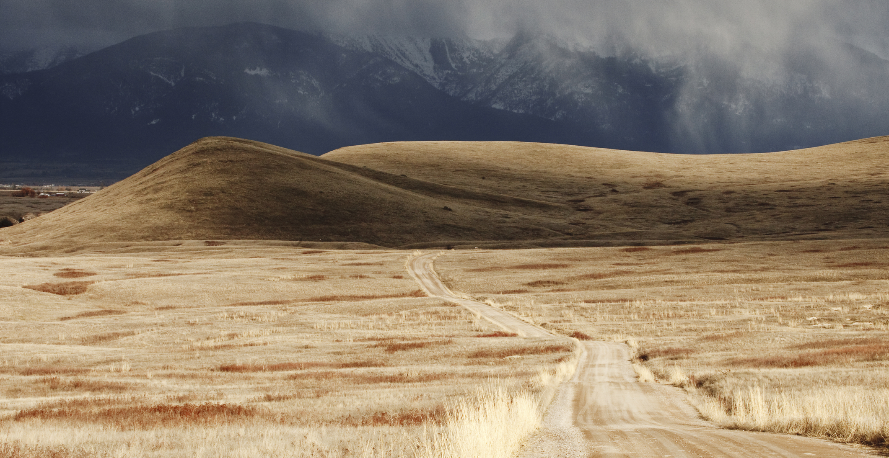

Slide 6
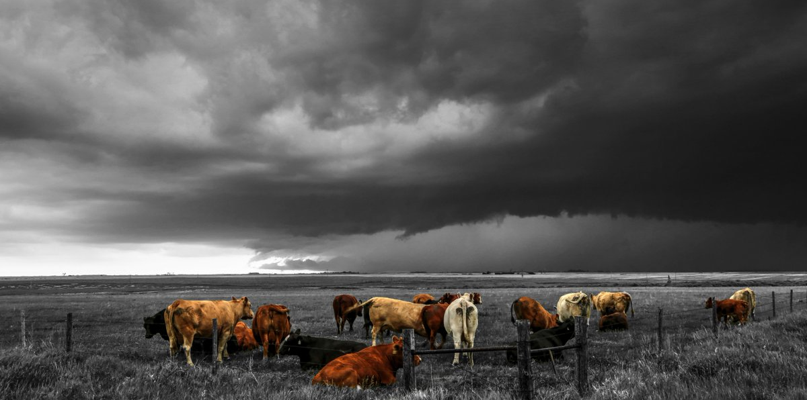

Slide 7
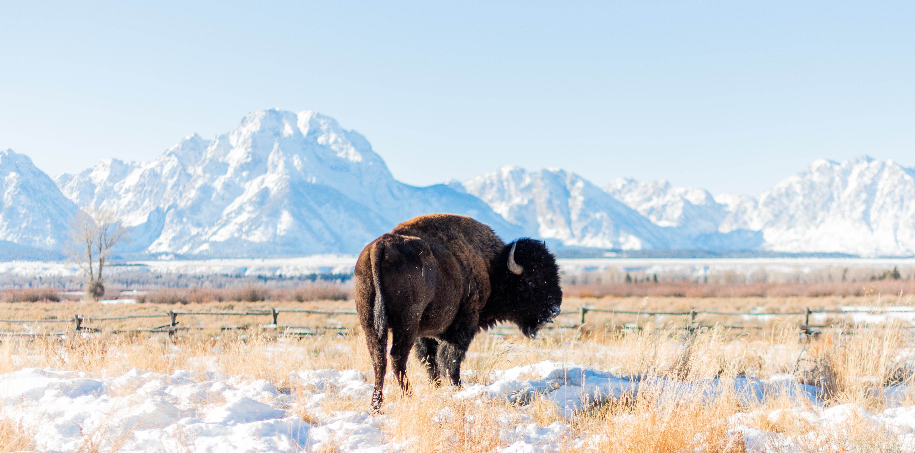
.

Slide 8
A few specifics
Preventative life skill solution focused support group
8 Sessions, open or closed groups
6-8 students ideal. 3 minimum, 10 maximum
MS, HS, and Teen Parent Curriculum
Led by school staff or community volunteers
Groups during the school day, not after school

Slide 9
Fist to five
How is your day going so far?
How are you feeling today?
How are things at work for you right now?

